Slide 1




NEXT GEN EMPLOYABILITY PROGRAM
Creating a future-ready workforce
Team Members
College Name
Student Name : Antoniet Shreya S
Student ID : au960221243004
Arunachala College of Engineering for Women

Slide 2

CAPSTONE PROJECT SHOWCASE
Project Title
Car Rentals Application with Django Framework
Abstract | Problem Statement | Project Overview | Proposed Solution | Technology Used | Modelling & Results | Conclusion

Slide 3
Abstract
Objective:
Our primary goal is to develop a robust data management system tailored specifically for a car rental company. This system will empower administrators to efficiently rent vehicles to customers.
User-Friendly Interface:
Emphasizing ease of use, our system will feature a highly intuitive interface. This ensures that both administrators and customers can navigate the platform seamlessly, enhancing user experience.
Admin Capabilities:
Administrators will have the capability to manage various aspects of the rental process. This includes confirming customer reservations, handling testimonials, and promptly addressing any issues that may arise during the rental period.
Benefits for Customers and Admin:
By implementing this system, we aim to provide significant benefits to both customers and administrators. Customers will enjoy a smoother and more convenient rental experience, while administrators will experience improved efficiency in managing rental operations.

Slide 4
Problem Statement
In the current system, users or customers engage directly with car owners to determine car availability and rental terms. Subsequently, if the car is available, the owner facilitates the rental process.
However, a notable drawback of this system is the necessity for customers to physically meet with the car owner, resulting in time wastage.
Ideally, users should have the ability to directly interface with the owner to book the car, eliminating the need for face-to-face meetings.
This discrepancy in fulfilling client or customer requirements presents a significant challenge.

Slide 5
Project Overview
In this car rental system, we propose the introduction of an online booking platform for renting cars.
Our objective is to develop and implement a robust database management system tailored specifically for a car rental company.
Leveraging user interface technologies such as HTML and CSS, we aim to ensure a seamless and user-friendly experience for customers.
Administrators will have the authority to review customer booking requests and determine whether to approve or decline car rentals.
By centralizing this process, we aim to streamline operations and enhance efficiency.

Slide 6
Proposed Solution
.
In the proposed car rental system, users can seamlessly interact through our dedicated system or application, enabling them to book a car online with minimal time investment.
This streamlined process benefits both users and car rental providers, eliminating the need for direct contact with the owner.
Additionally, our system supports remote access, allowing users to make bookings from any location with internet connectivity.
Furthermore, our comprehensive car rental system offers a wide selection of vehicle brands available for rent, catering to diverse customer preferences and needs.

Slide 7


Technology Used
Front-end
Back-end

Slide 8
Modelling & Results
In the near future, our car rental system aims to incorporate GPS tracking functionality, allowing clients to track the location of their rented vehicles in real-time. Additionally, we plan to introduce new features such as 'pay after the trip,' providing users with added flexibility and convenience in payment methods.
Furthermore, we are actively working on increasing automation within the system to enhance user experience significantly. This includes streamlining rental processes and implementing agreements that allow customers to utilize the vehicle as if it were their own.
By integrating these advancements, our car rental system not only increases operational efficiency but also meets and exceeds customer expectations, ultimately leading to business growth and enhanced customer satisfaction.

Slide 9
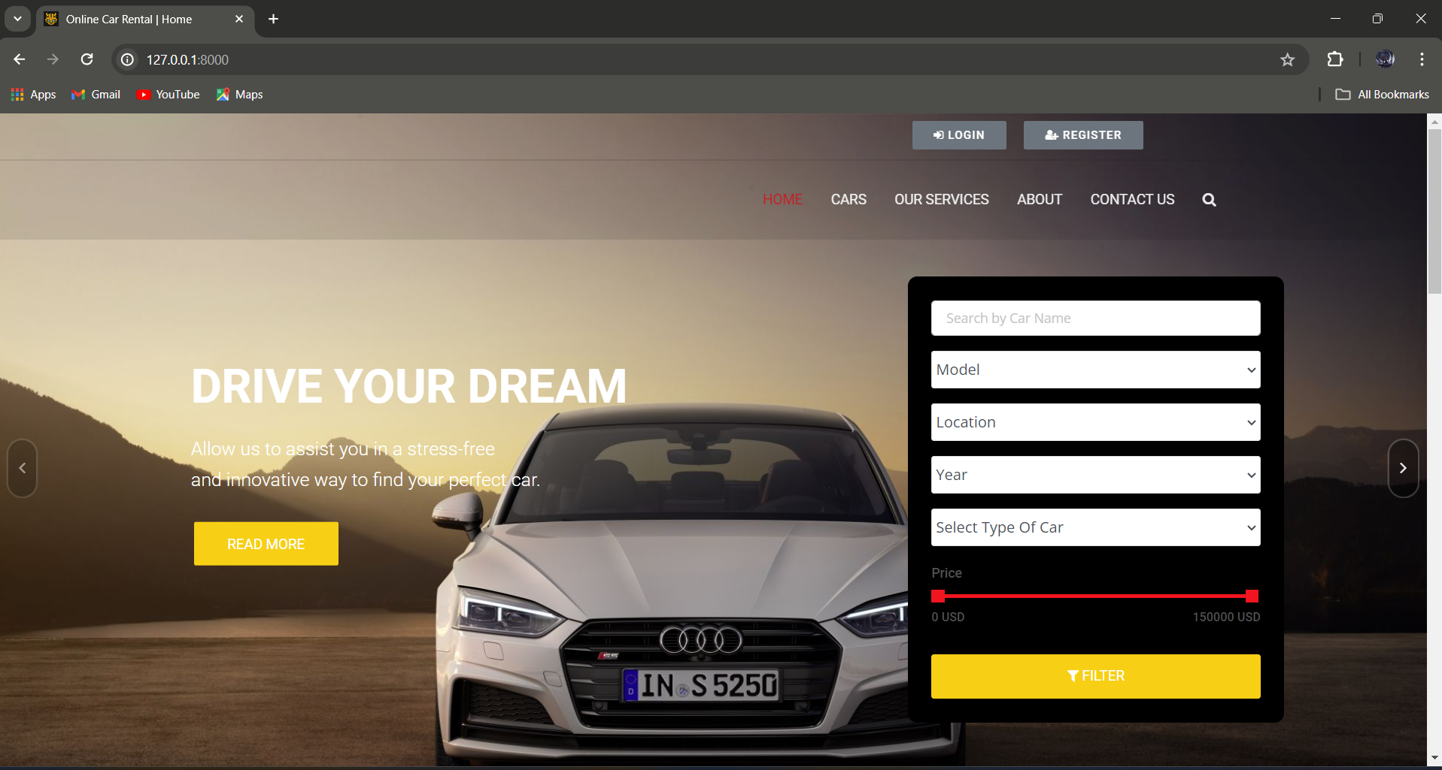
Homepage

Slide 10
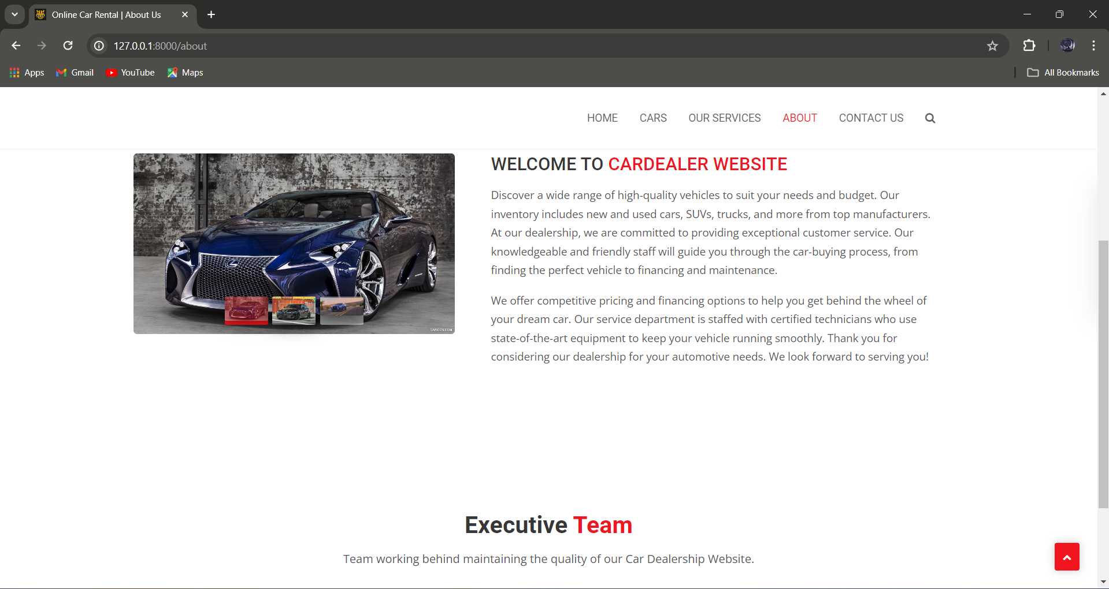
About-Us-Page

Slide 11
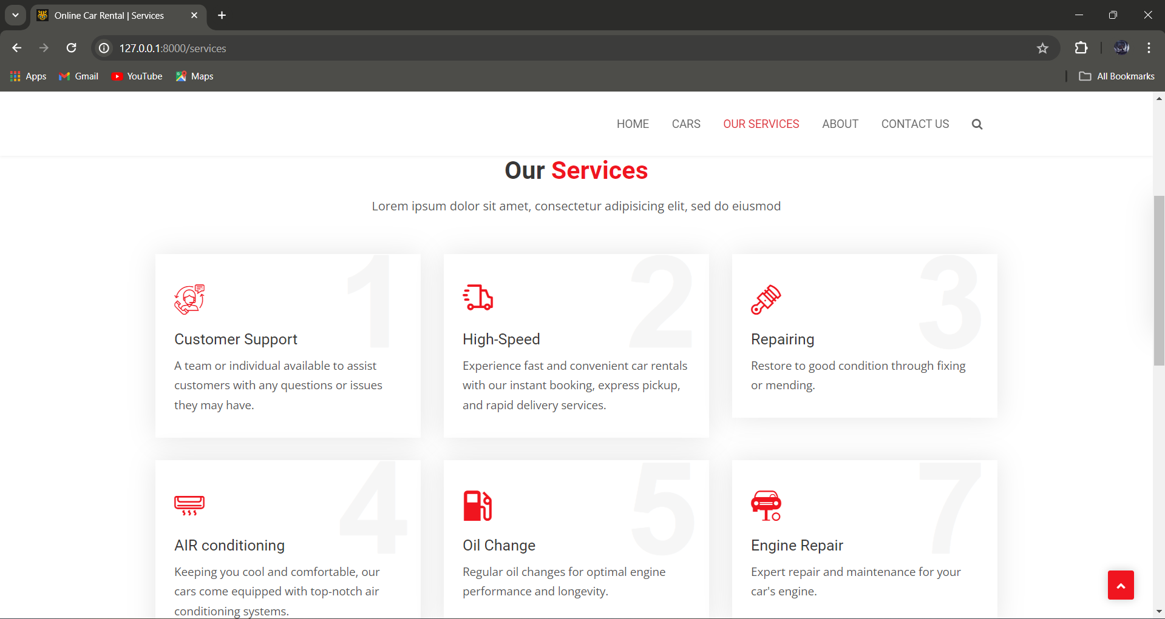
Service-Page

Slide 12
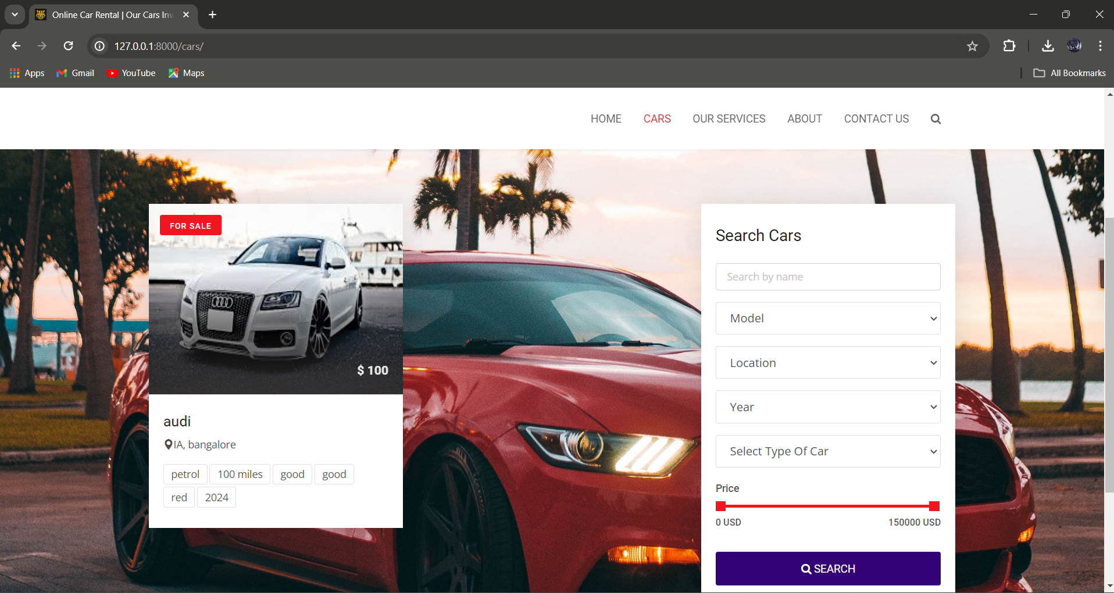
Departments-Page

Slide 13
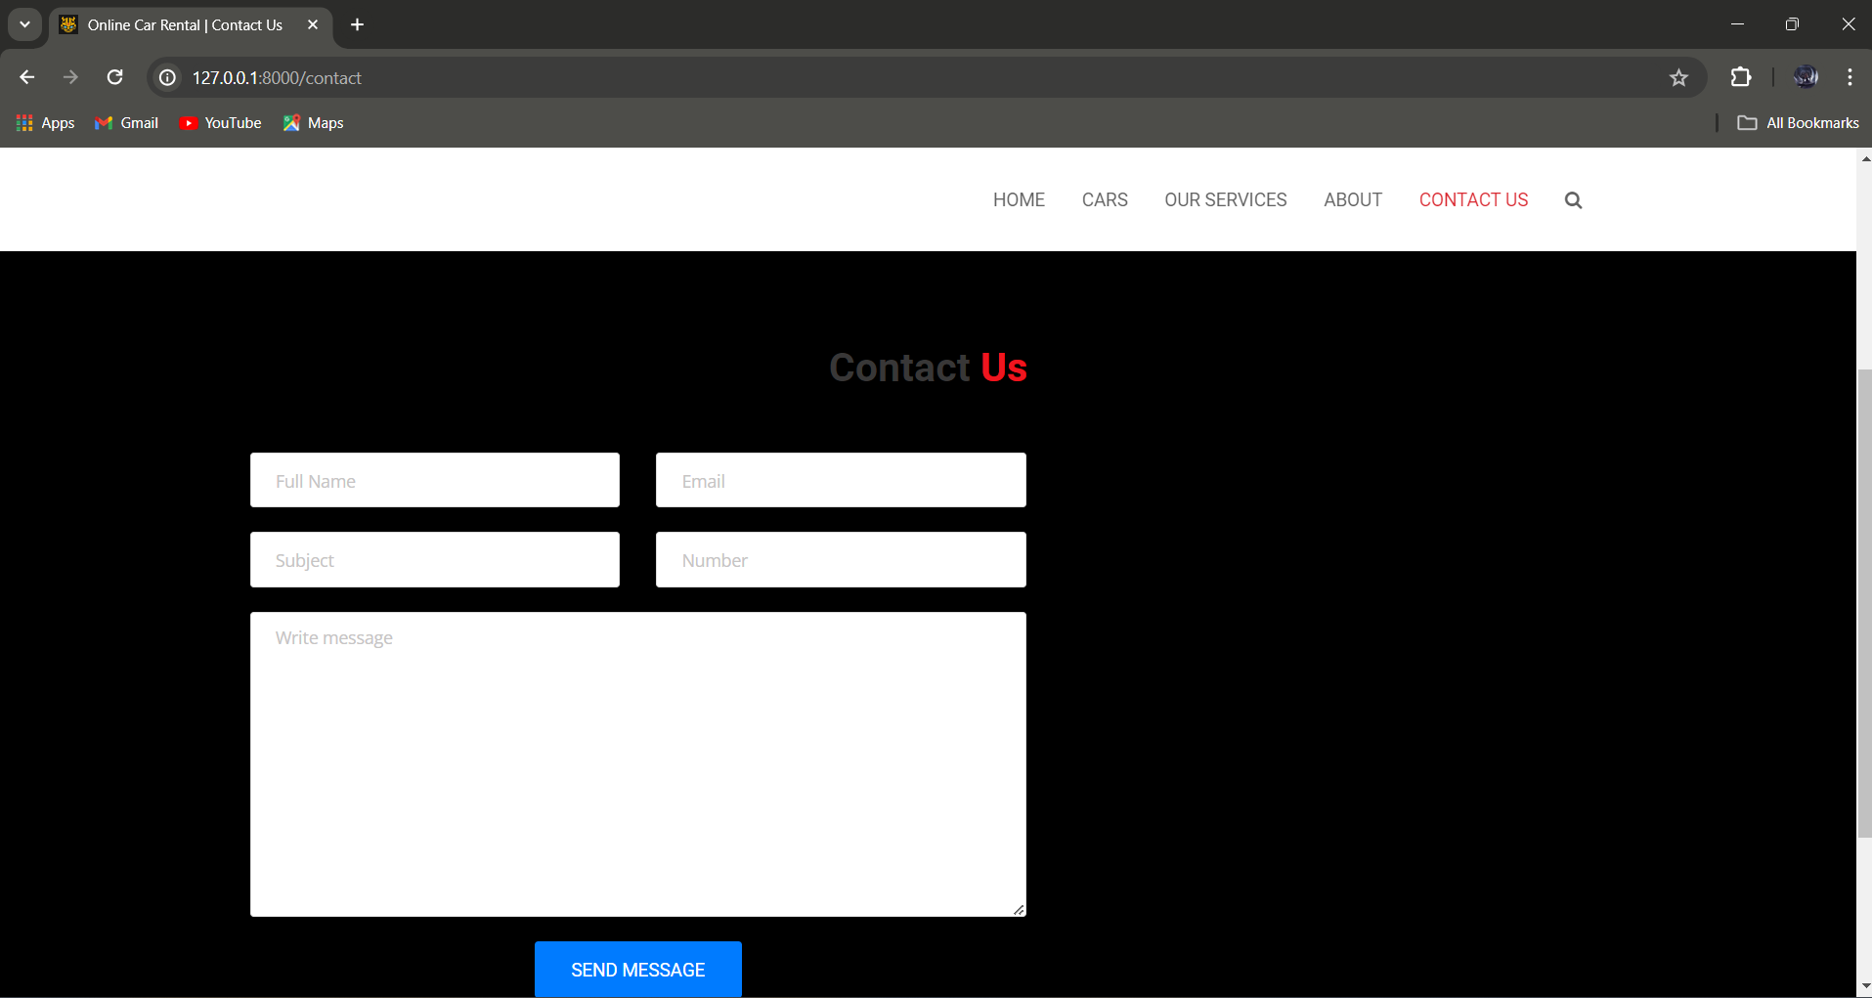
Blog-Page

Slide 14
Future Enhancements:
In our future plans for the application, we are committed to enhancing its functionality by introducing additional features aimed at improving user experience.
These features include GPS tracking, which will provide users with real-time location information, enhancing safety and convenience.
Furthermore, we are dedicated to optimizing costs while simultaneously increasing customer satisfaction. This may involve implementing strategies to offer competitive pricing without compromising on service quality.
Additionally, we recognize the importance of addressing the concerns of all our customers. Therefore, we are committed to investing more time and effort into understanding and satisfying the needs of our diverse customer base, ensuring their continued satisfaction with our services."

Slide 15
Conclusion
The car rental application stands as a highly valuable tool in today's landscape, offering unparalleled convenience with its remote location access feature.
This addresses the pressing needs of today's generation, who value flexibility and accessibility in their daily activities.
Moreover, the application's friendly user interface ensures ease of use for all users, catering to a wide audience demographic.
With its seamless accessibility and user-friendly design, the car rental application remains an indispensable resource for modern consumers.

Slide 16
Thank You!
Notes:
Thank You !!

